Slide 1
Business Systems Intelligence
Lecture 4
Data Warehousing - III

Slide 2
What did we do last time?

Slide 3
How do we model data in the Data Warehouse?
Entity-Relationship (ER) Modelling
ER modelling is a design technique in which we store the data in highly normalized form inside a relational database.
Dimensional Modelling
Star Schemas

Slide 4
ER Modelling: Where is the catch?
Lets have a look at a typical ER data model first

Slide 5
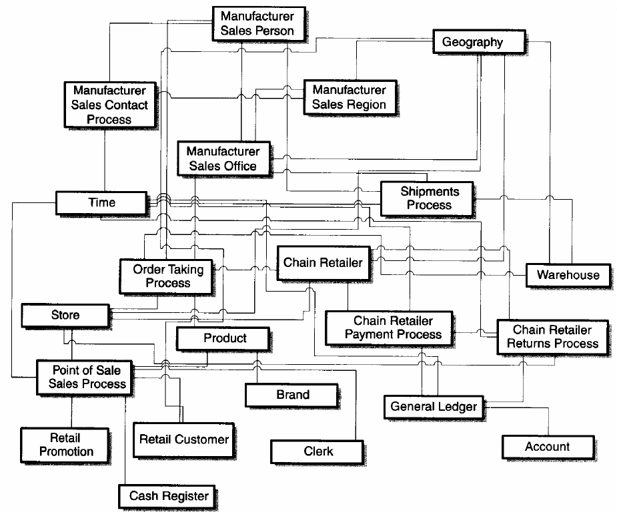
A Typical OLTP Oriented ER Data Model

Slide 6
ER Modelling: Where is the catch?
Some Observations
A Symmetric Model
All the tables look the same.
Which table is more important? Which one is the largest?
Which tables contain numerical measurements of the business?
Which table contain nearly static descriptive attributes?
Very hard to visualize and keep it in head.
A large number of possible connections to any two (or more) tables.

Slide 7
ERD: the Catch Continues
ERD and Normalization result in large number of tables
Hard to be understood by the users (DB programmers)
Hard to navigate by DBMS software in an optimum way
Real value of ERD is in using tables individually or in pairs.
Too complex for queries that span multiple tables with a large number of records.

Slide 8
Dimensional Modelling and the Star Schema

Slide 9
The Dimensional Model
Every dimensional model (DM) is composed of
One table with a composite primary key, called the fact table
A set of smaller tables called dimension tables
Each dimension table has a simple (non-composite) primary key that corresponds exactly to one of the components of the composite key in the fact table.

Slide 10
Star Schema
Dimension Table
Dimension Table
Fact Table
Dimension Table
Dimension Table

Slide 11
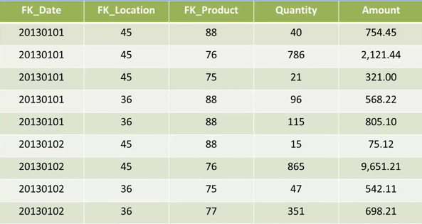
An example of a Fact Table

Slide 12
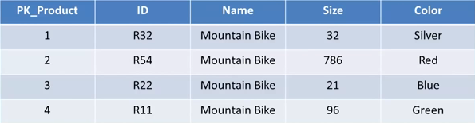
An example of a Dimension Table

Slide 13
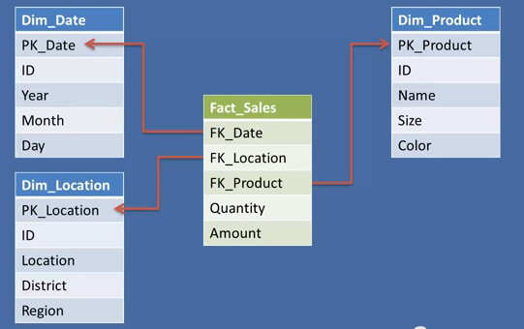
An example of a Dimensional Model

Slide 14
ER versus DM

Slide 15
ER Drawbacks
Data is not structured for analytical usage.
End users cannot understand or remember an ER model. End users cannot navigate an ER model. There is no graphical user interface (GUI) that takes a general ER model and makes it usable by end users.
Software cannot usefully query a general ER model.

Slide 16
DM Strengths
The dimensional model has a number of important data warehouse advantages that the ER model lacks.
First, the dimensional model is a predictable, standard framework. Report writers, query tools, and user interfaces can all make strong assumptions about the dimensional model to make the user interfaces more understandable and to make processing more efficient.

Slide 17
DM Strengths
A second strength of the dimensional model is that the predictable framework of the star join schema withstands unexpected changes in user behavior. Every dimension is equivalent.
The logical design can be done independently of expected query patterns. The user interfaces are symmetrical, the query strategies are symmetrical, and the SQL generated against the dimensional model is symmetrical.

Slide 18
DM Strengths
A 3rd strength of the DM is that it is ‘gracefully extensible’ to accommodate unexpected data elements and new design decisions.
All existing tables can be changed in place by simply adding new data rows in the table, or a table can be changed in place with a SQL alter table command.
Facts consistent with the existing grain can be added by creating new columns.
Dimensions can be added to an existing fact table by creating new foreign key columns, if they don’t alter the grain.
Attributes can be added to an existing dimension table by creating new columns.
Data should not have to be reloaded. No query tool or reporting tool needs to be reprogrammed to accommodate the change.
Old applications continue to run without yielding different results by adding new unanticipated facts.

Slide 19
Designing a Data Warehouse

Slide 20
Data Model Design for Data Warehouses
Mart
Nine-Step Methodology includes following steps:
Choosing the subjects
Choosing the grain
Identifying and conforming the dimensions
Choosing the facts
Storing pre-calculations in the fact table
Rounding out the dimension tables
Choosing the duration of the database
Tracking slowly changing dimensions
Deciding the query priorities and the query mode
Notes:
The IBM Cognos Dynamic Query Mode is an enhanced Java-based query mode which offers the following key capabilities:
Query optimizations to address query complexity, data volumes and timeliness expectations with improved query execution techniques
Significant improvement for complex OLAP queries through intelligent combination of local and remote processing and better MDX generation

Slide 21
Outline of today’s lecture
Modelling and using the Data Warehouse
Dimensional Modelling (Part 2)
From Star Schema to Snowflakes
Querying and Cubes

Slide 22
Dimensional Modelling (Part 2)

Slide 23
Data Model Design for Data Warehouses
Mart
Nine-Step Methodology includes following steps:
Choosing the subject
Choosing the grain
Identifying and conforming the dimensions
Choosing the facts
Storing pre-calculations in the fact table
Rounding out the dimension tables
Choosing the duration of the database
Tracking slowly changing dimensions
Deciding the query priorities and the query mode
This is the general Dimensional Modelling design process that we looked at previously. We more often think of the design process as converting from an Entity Relation Diagram to a DM Diagram.

Slide 24
The Conversion Process (Summary)
To create the individual ‘stars’ that exist within an application:
Identify the Business Process in the ER model
Look for many-to-many relationships in the ER model containing numeric and additive facts and to designate them as fact tables.
Alternatively, look for ‘events’ or ‘transactions’ – these may also be facts
Denormalize all of the remaining tables into flat tables with single-part keys that connect directly to the fact tables. These tables become the dimension tables.
In cases where a dimension table connects to more than one fact table, we represent this same dimension table in multiple schemas, and we refer to the dimension tables as "conformed" between the dimensional models.

Slide 25
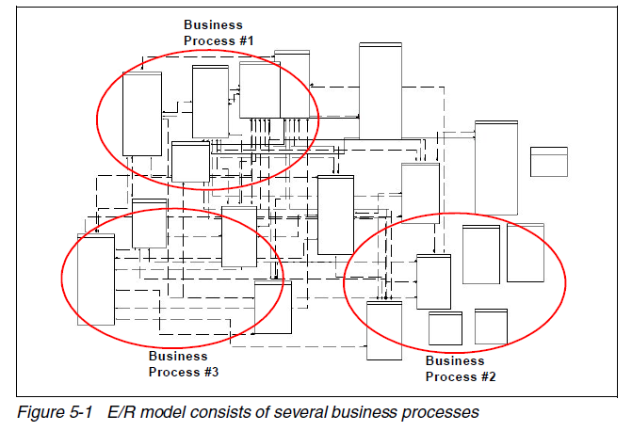
Identify the Business Process

Slide 26
Identify Transaction Tables
The idea behind this step is to identify the transaction-based tables that serve to express many-to-many relationships inside an ER model.
Every ER model consists of transaction-based tables which constantly have data inserted, or are updated with data, or have data deleted from them.
For example, in an business database, there are transaction tables, such as Invoice and Invoice_Details, which are constantly inserted and updated because they are transaction-based tables.
Tables such as Employee and Products in an E/R model may be fairly static.

Slide 27
Denormalization
Taking the remaining tables in the ER model and denormalizing them into dimension tables for the dimensional model.
The primary key of each of the dimensions will be a surrogate (non-intelligent, integer) key.
This surrogate key connects directly to the fact table.

Slide 28
Date and Time
The last step generally involves identifying the date and time dimension.
Dates are generally stored in the form of a date timestamp column inside the ER model.
Date and time-related columns are generally found in the transaction-based tables.

Slide 29
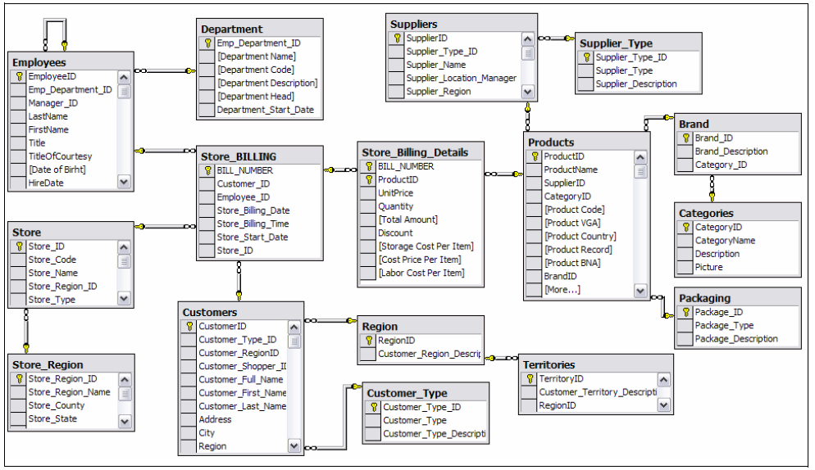
Example ER/DM Conversion
Notes:
This is the physical diagram.
The relationship between Bill and Product is many-to-many.

Slide 30
Identify Business Process - Sales

Slide 31
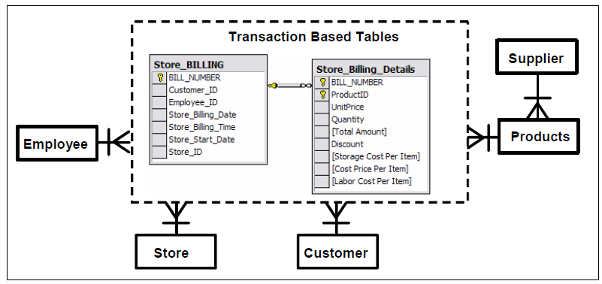
Identify Transaction Based Table

Slide 32
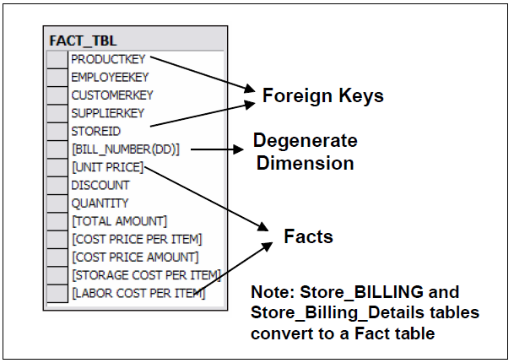
Construct Fact Table

Slide 33
Degenerate Dimension
A degenerate dimension is a dimension without attributes. It is a transaction-based number which resides in the fact table.
The Bill Number should be placed inside the fact table right after the dimensional foreign keys and right before the numeric facts.
The Bill Number, in SQL, serves as a GROUP BY clause for grouping all the products purchased in a single transaction.
All information (such as date of purchase and products purchased) relating to the Bill Number has been allocated to different dimensions.
The Bill Number degenerate dimension is there because the grain we chose represents a single transaction line item.

Slide 34
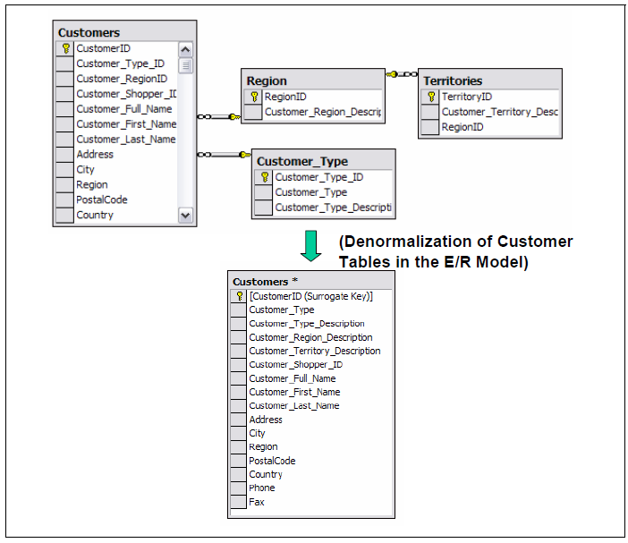
Denormalization: Customers

Slide 35
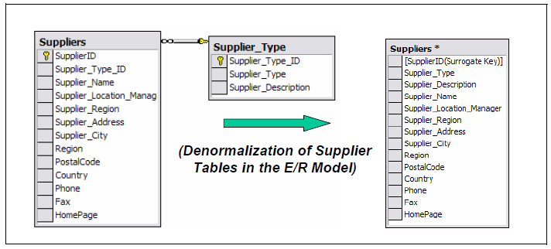
Denormalization: Suppliers

Slide 36
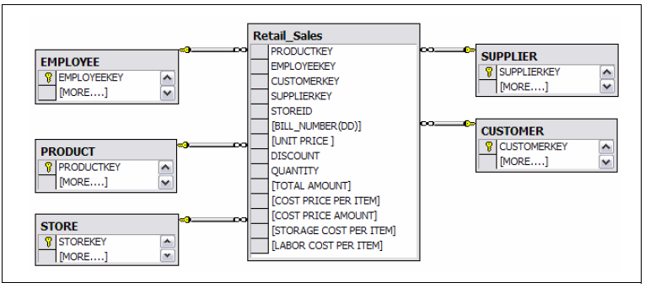
Initial Dimensional Model

Slide 37
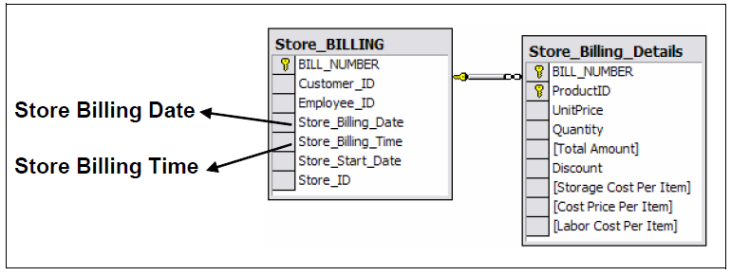
Date and Time Information

Slide 38
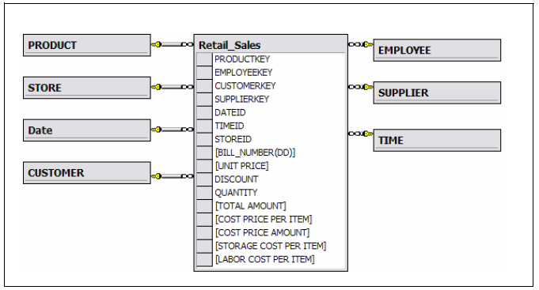
Final Dimensional Model

Slide 39
An Exercise

Slide 40
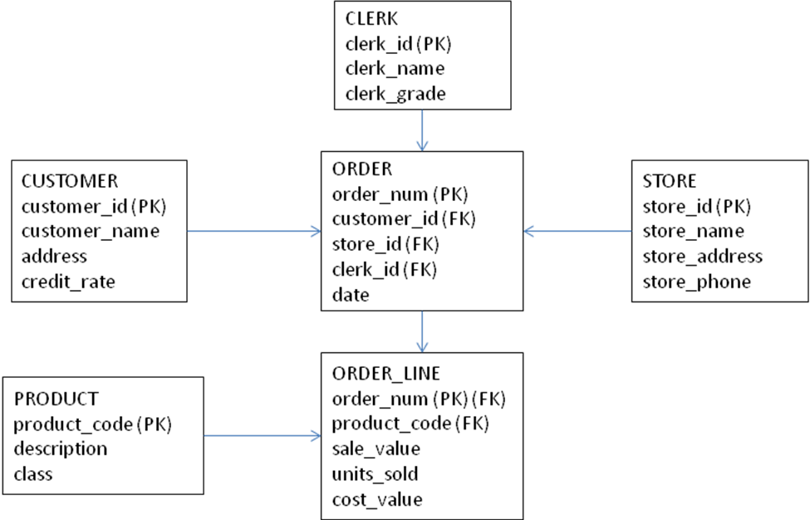
Conversion Example
A large wholesale builders merchants requires a new data warehouse to record and subsequently analyze its sales history. The current sales records system includes is represented by the following ER diagram:
Produce and justify a suitable star schema for the above ER diagram.

Slide 41
From Stars to Snowflakes

Slide 42
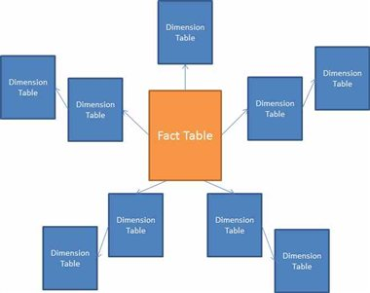
Different Types of Dimensional Model
The star-schema can be extended in a number of ways. The most important of these is the Snow flake model.
Snowflake
Like the Star Schema except that dimensions are normalized to reduce data redundancy

Slide 43
Example Star Schema
time
time_key
day
day_of_the_week
month
quarter
year
item
item_key
item_name
brand
type
supplier_type
Sales Fact Table
time_key
item_key
branch_key
branch
location
location_key
branch_key
branch_name
branch_type
location_key
street
city
state_or_province
country
units_sold
dollars_sold
avg_sales
Measures

Slide 44
Example Snowflake Schema
time
time_key
day
day_of_the_week
month
quarter
year
item
item_key
item_name
brand
type
supplier_key
supplier
Sales Fact Table
supplier_key
supplier_type
time_key
item_key
branch_key
branch
location
location_key
branch_key
branch_name
branch_type
location_key
street
city_key
units_sold
dollars_sold
city
avg_sales
city_key
city
state_or_province
country
Measures

Slide 45
Star versus Snowflake Schema
 | Snowflake Schema | Star Schema
Dimension table: | It may have more than one dimension table for each dimension | Contains only single dimension table for each dimension
Query Performance: | More foreign keys-and hence worse execution time | Less foreign keys and hence better query execution time
Ease of maintenance/change: | No redundancy and hence easier to maintain and change | Has redundant data and hence more difficult to maintain/change
Type of Datawarehouse: | Good to use for small data warehouses/marts | Good for large datawarehouses
Joins: | Higher number of Joins | Fewer Joins
Ease of Use: | More complex queries and hence less easy to understand | Less complex queries and easy to understand
http://www.diffen.com/difference/Snowflake_Schema_vs_Star_Schema

Slide 46
From Stars to Cubes

Slide 47
From Stars to Cubes
While a Star Schema is essentially still a relational model, it can sometimes be easier to think about and to work with different abstractions of the data.
A Cube is often derived from a relational star schema. Contains the dimensional attributes and facts, but it is accessed through languages with more analytic capabilities than SQL.
The physical implementation differs: a star schema is a DM implemented in relational DBMS; an OLAP cube is a DM implemented in a multidimensional DB environment
A MDB allows questions related to summaries
An OLAP cube is often the final step in the deployment of a dimensional DW/BI system, or it may exist as an aggregate structure based on a more atomic relational star schema.
Notes:
"How many Phones have been sold in Nebraska so far this year?"

Slide 48
Overview
Data Cubes are an easy way to look at the data (allow us to look at complex data in a simple format).
The cubes provide fast access to pre-computed summarized data, this benefits fast analysis.
Although called a "cube", it can be 2-dimensional, 3-dimensional, or higher-dimensional.

Slide 49
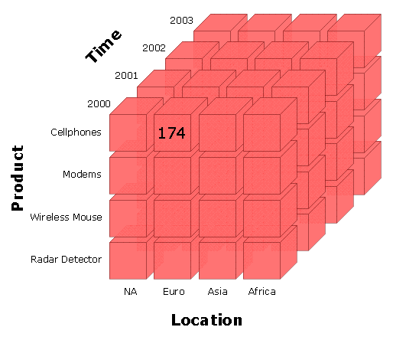
Dimensions and Measures
Data is stored and indexed using aggregations or pre-calculated summary tables. Consequently, cubes deliver superior query performance. Business users can drill down or up by adding or removing attributes without issuing new queries. OLAP cubes also provide more analytically robust functions than SQL, but you pay a load performance price for these capabilities, especially with large data sets.

Slide 50
Data Cube Concepts
Three important concepts associated with data cubes:
Slicing
Dicing
Rotating

Slide 51
Slicing
The term slice most often refers to a two-dimensional page selected from the cube.
Subset of a multidimensional array corresponding to a single value for one or more members of the dimensions not in the subset.

Slide 52
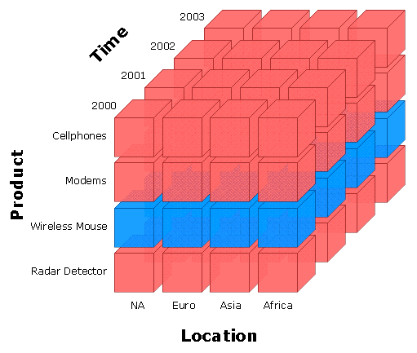
Slicing
Slicing-Wireless Mouse

Slide 53
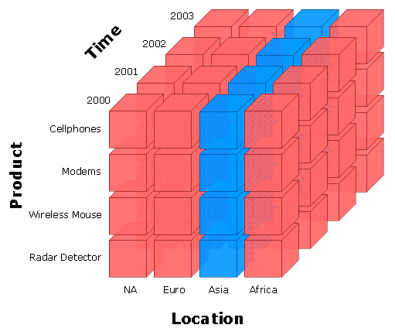
Slicing
Slicing-Asia

Slide 54
Dicing
A related operation to slicing .
In the case of dicing, we define a sub-cube of the original space.
Dicing provides you the smallest available slice.

Slide 55
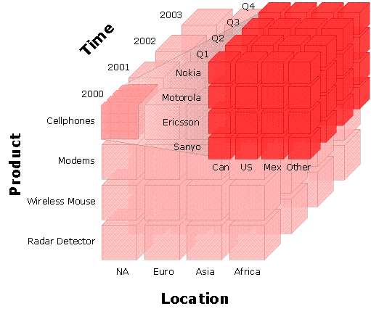
Dicing

Slide 56
Rotating
Sometimes called pivoting.
Rotating changes the dimensional orientation of the report from the cube data.
For example:
Rotating may consist of swapping the rows and columns, or moving one of the row dimensions into the column dimension.
Or swapping an off-spreadsheet dimension with one of the dimensions in the page display.

Slide 57
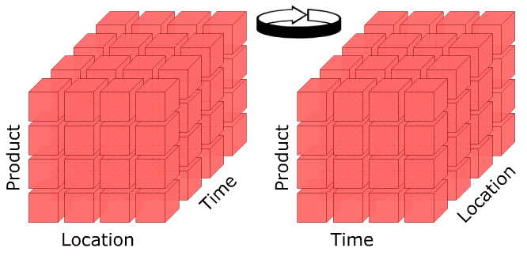
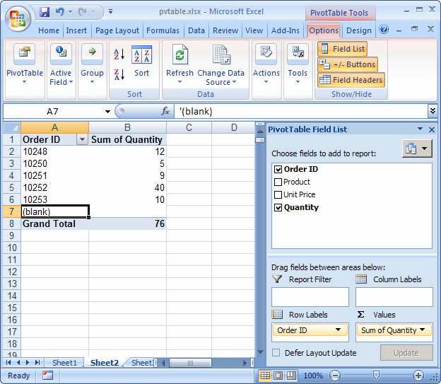
Rotating

Slide 58
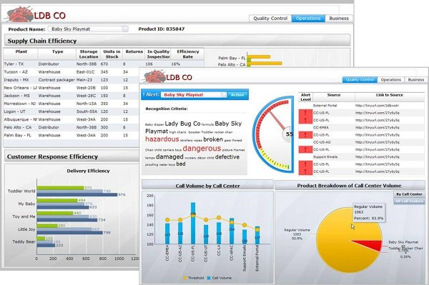
Query Tools / Frontends
SAP Business Objects

Slide 59
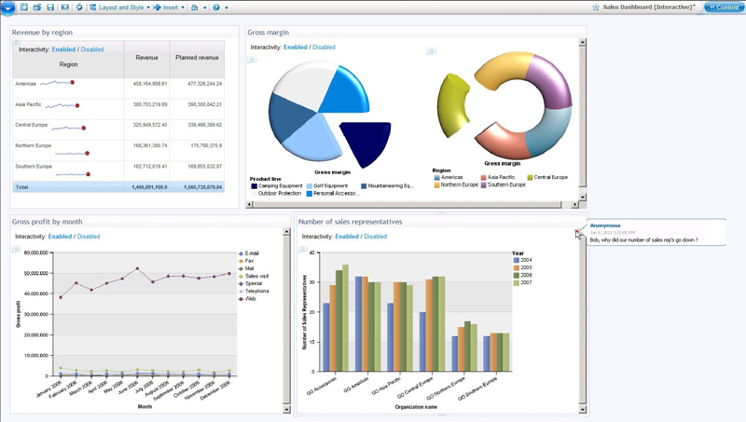
Query Tools / Frontends
IBM Cognos BI

Slide 60
Closing Notes

Slide 61
Summary
Over the last three lectures we have introduced the idea of data warehouses.
Data warehouses evolved to address the issues of using transactional databases to answer new kinds of questions.

